Slide 1


SMART INDIA HACKATHON 2025
Problem Statement ID – SIH25135
Problem Statement Title- Student Innovation
Theme- Smart Automation
PS Category- Software
Team ID-59953
Team Name: SamadhanX

Slide 2
SMART GRIEVANCE TRACKER
SamadhanX
How it addresses the problem:
Faster Resolutions – Automated routing, duplicate detection, SLA-based escalations
Transparency – Blockchain guarantees records cannot be altered
Trust & Engagement – Citizens track live updates & feedback loops
Data-driven System – Streamlined governance through actionable data
Innovation & Uniqueness:
Combines AI for automated classification, prioritization & sentiment-based urgency detection
Blockchain ensures tamper-proof, transparent complaint logs(Future Scope)
Real-time updates empower both citizens & the department
First-of-its-kind dual approach: automation + accountability

Slide 3
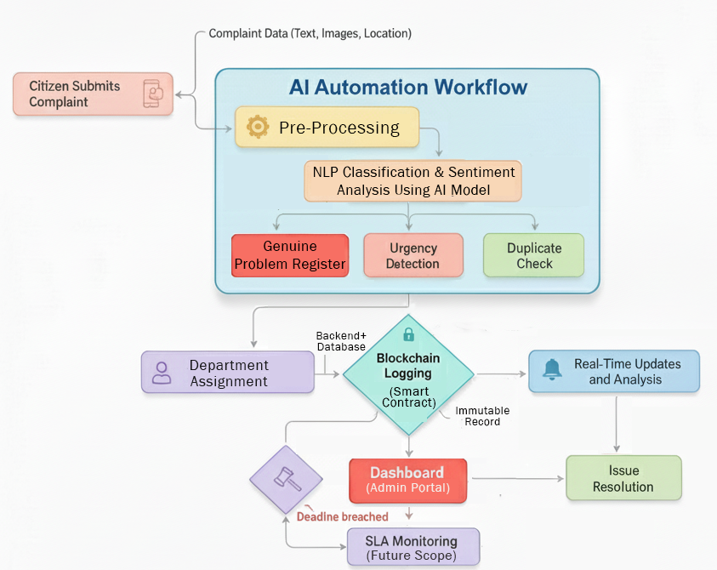
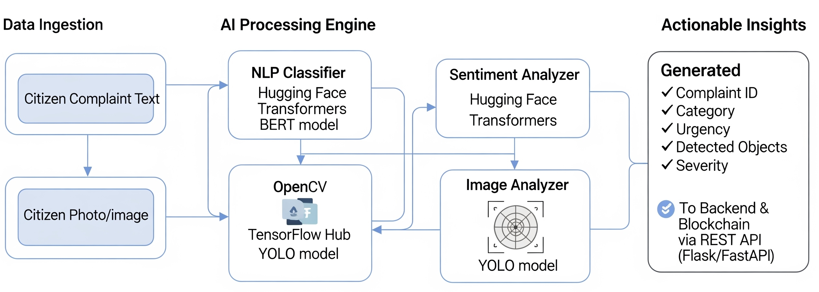
TECHNICAL APPROACH
SamadhanX
Technologies to be Used:
Frontend: React.js
Backend: Node.js + Express
Database: MongoDB
AI/ML: Python
Blockchain: Ethereum Testnet

Slide 4
FEASIBILITY AND VIABILITY
SamadhanX
Feasibility:
Technical: AI & blockchain stack tested, scalable across cities
Economic: Reduces manpower load, long-term savings for municipalities
Operational: Cloud deployment ensures scalability
Regulatory: Aligned with smart city governance goals
Challenges & Risks:
AI model misclassification
Blockchain transaction costs
Problem Redressal Success Rate
Solutions:
Proper AI processing for genuine complaint registration
Blockchain networks to ensure immutability and transparency
SLA timers and auto-escalation
API-based modular integration with department admin portal

Slide 5
IMPACT AND BENEFITS
SamadhanX
Benefits:
Automation & Efficiency: Faster, error-free complaint handling.
Transparency & Trust: Immutable blockchain logs.
Accountability: SLA monitoring + escalation system.
Citizen Empowerment: Real-time tracking, notifications, and feedback.
Potential Impact:
Citizens: Transparency, faster resolutions, greater trust in governance.
Authorities: Data-driven decision-making and SLA accountability.
Governance: Reduced delays, improved participation, scalable to multiple cities.

Slide 6
RESEARCH AND REFERENCES
SamadhanX
Responsive Public Grievance Redressal System for efficient Public Service Delivery:
https://www.tatatrusts.org/Upload/Content_Files/case%20study-surat-pgr.pdf
Artificial Intelligence and Blockchain Technologies for Smart City: https://onlinelibrary.wiley.com/doi/full/10.1002/9781119816096.ch15

